Slide 1
Coding Dojo Big Data
Session 3/8: Kafka Connect

Slide 2
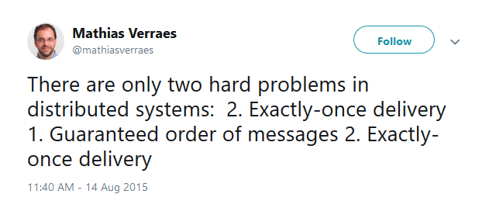
Data is moving… fast

Slide 3
Data transport: Kafka
Kafka
Message Bus (Publish/Subscribe)
Data store
Data processing
Connect to external systems
Exactly once semantics

Slide 4
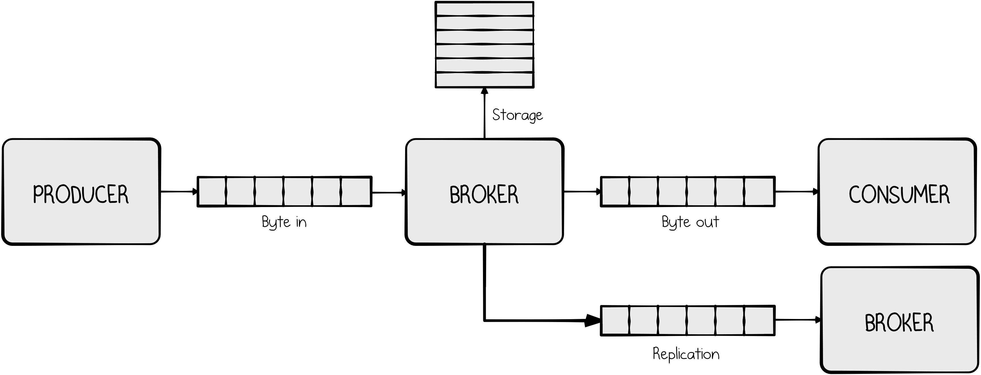
Kafka: Brokers, Producers, Consumers

Slide 5
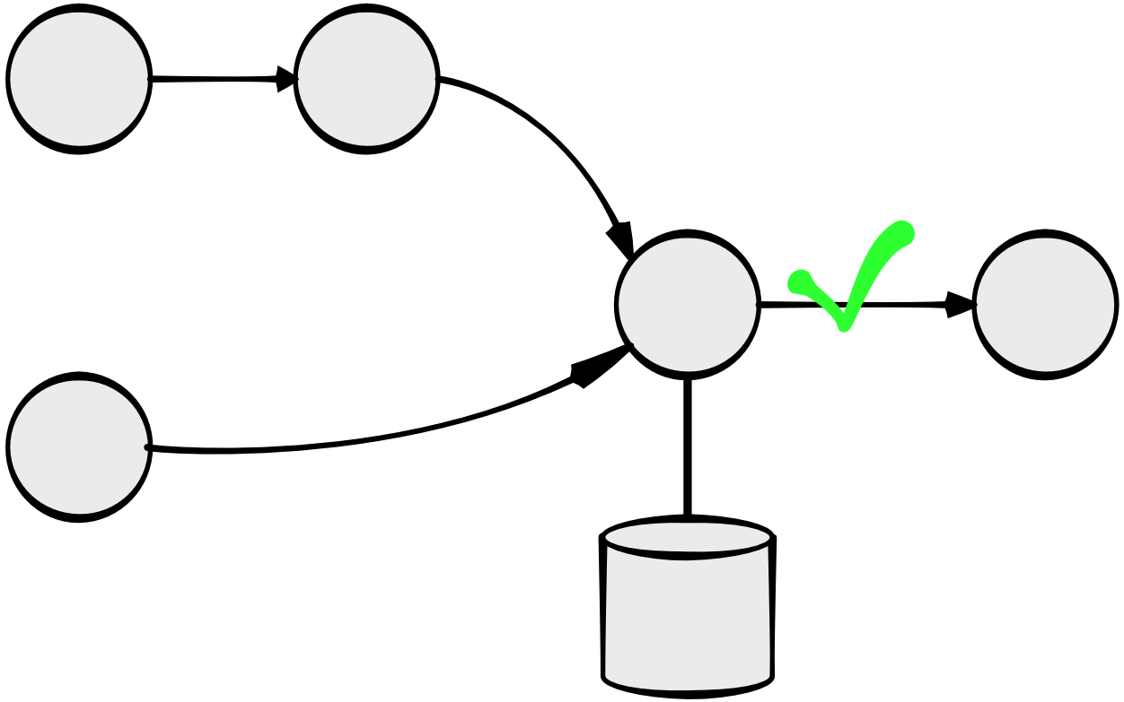
Kafka Streams
Stream processing
Exactly once processing
__consumer_offsets topic
<appId>-<STORE>-changelog topic
<output> topic
Topology = DAG (Dependency Acyclic Graph)
High level and low-level processing
Stateless and Stateful (with RocksDB)
State restoration at startup
Interactive queries (NAMED store only)

Slide 6
Kafka Connect
A link to the past
Connect legacy systems to Kafka
Exactly once is almost there
Expose data
Cassandra
Elasticsearch
Exactly once if atomic transactions
…
Configuration > Code
Code once, reuse multiple times
Or use off-the-shelf connectors

Slide 7
Internals
Workers
Standalone
Distributed (cluster)
Connectors
Configuration
Source connectors
Sink connectors
Tasks
Process the data

Slide 8
Internals
Topics
Configs
Status
Offsets
Data format: Avro
Schema registry
Compatibility

Slide 9
Kafka Connect: Hands-on
Data
Reference (MySQL): (user_id, name, …)
Event: (user_id, message)
Producer
Produce event records
Source connector
MySQL to Kafka
Processing
Join Reference and Event, produce JSON
Sink Connector
Kafka to Elasticsearch

